Slide 1
Design Space Exploration in CyberWorkBench
Using Ant Colony Optimization Heuristic
Mark Sears
11/4/2019

Slide 2
Design Space Exploration
Performing HLS can give vastly different results depending on the options used during synthesis. By tuning different “knobs”, the design space can be explored and the best results found.
Functional Units (FUs)
Pragmas
Global Options

Slide 3
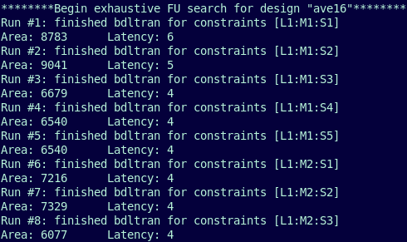
Functional Unit Exhaustive Search
Perform HLS using different constraints on the Functional Units.
Each iteration, increase the number of allowed FUs until no change is seen.
Repeat until all possible FU combinations have been explored.

Slide 4
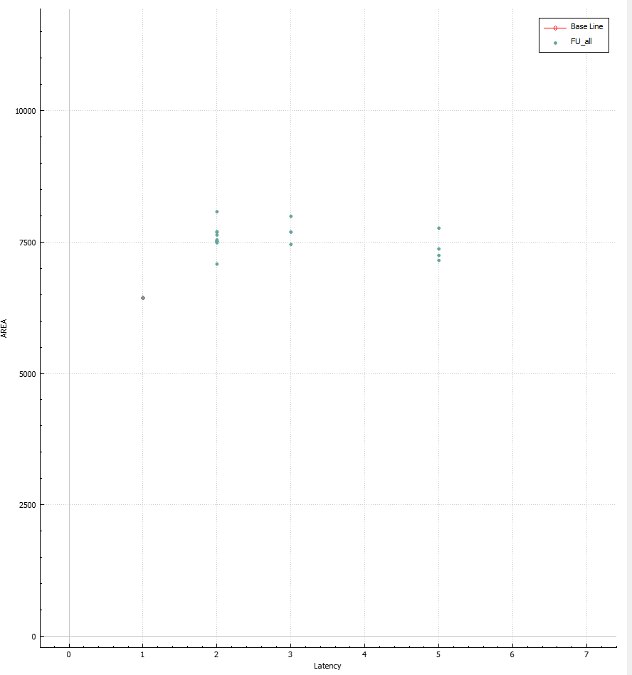
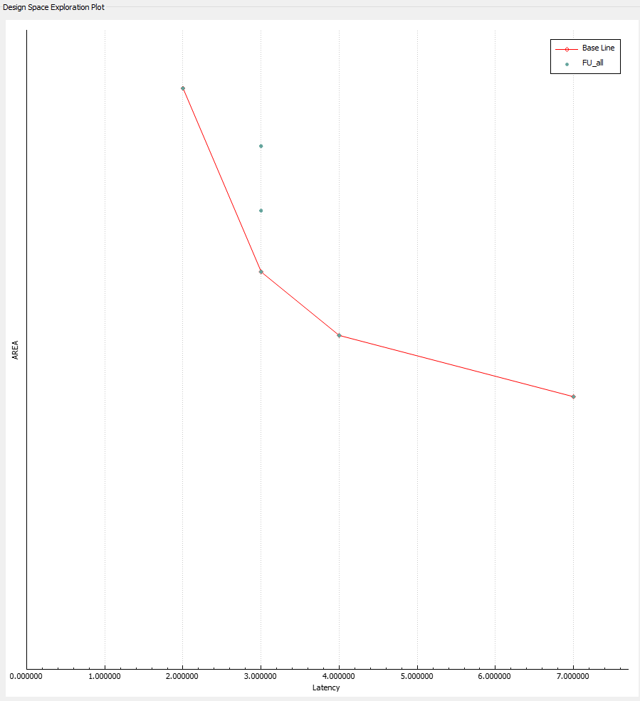
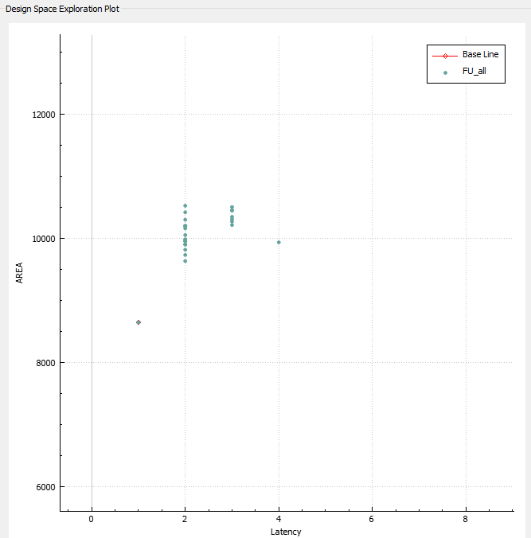
FU Search Results
ave16
sobel
kasumi

Slide 5
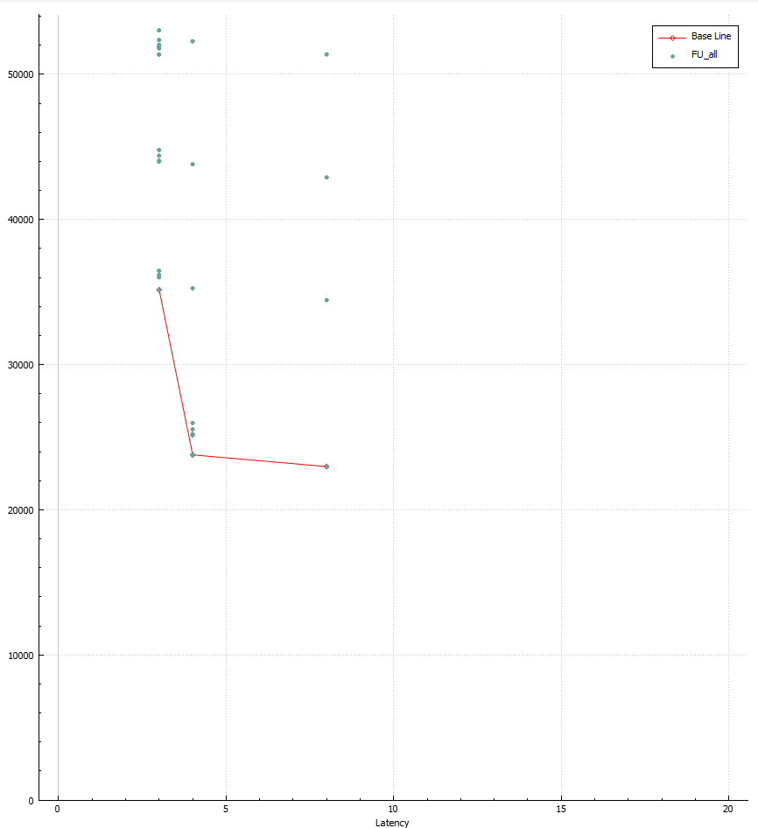
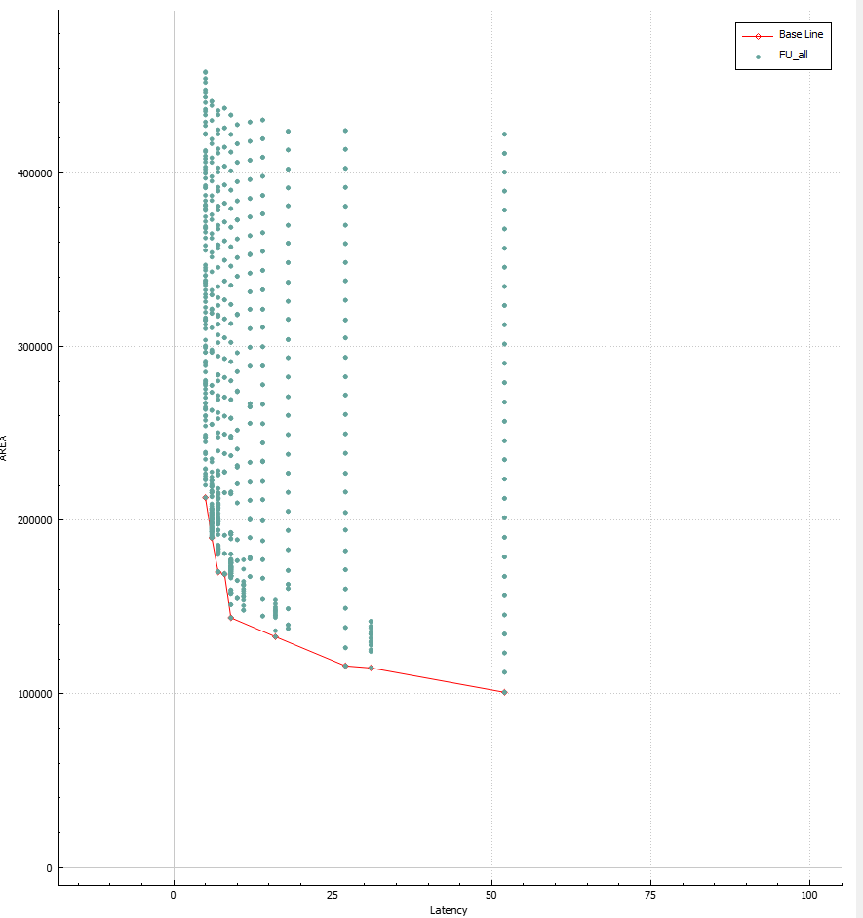
interpolation
decimation

Slide 6
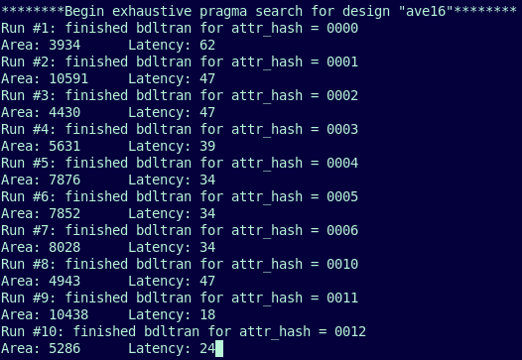
Pragma Exhaustive Search
Perform HLS using different combinations of pragmas.
Cycle through every possible combination to find the absolute best synthesis options.
Takes a very long time for large designs!

Slide 7
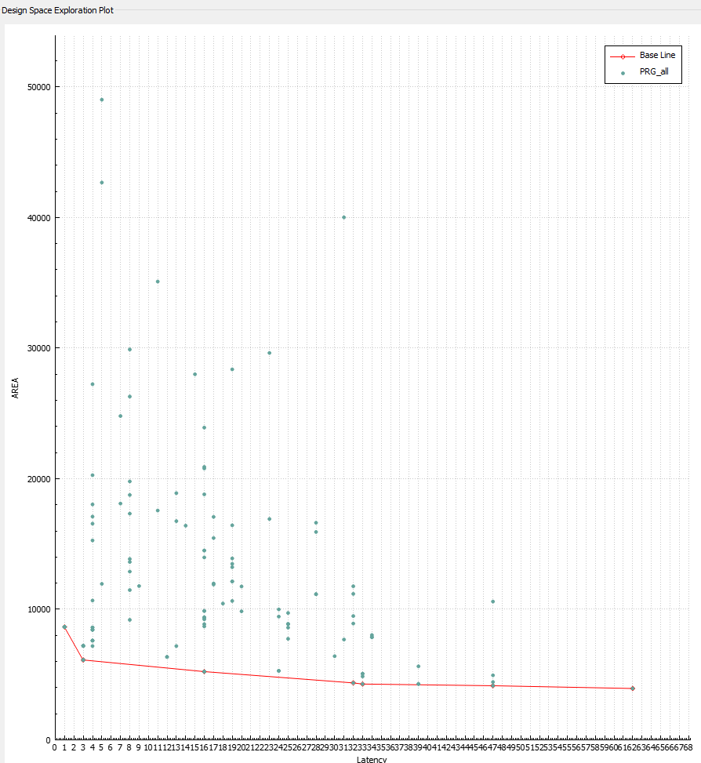
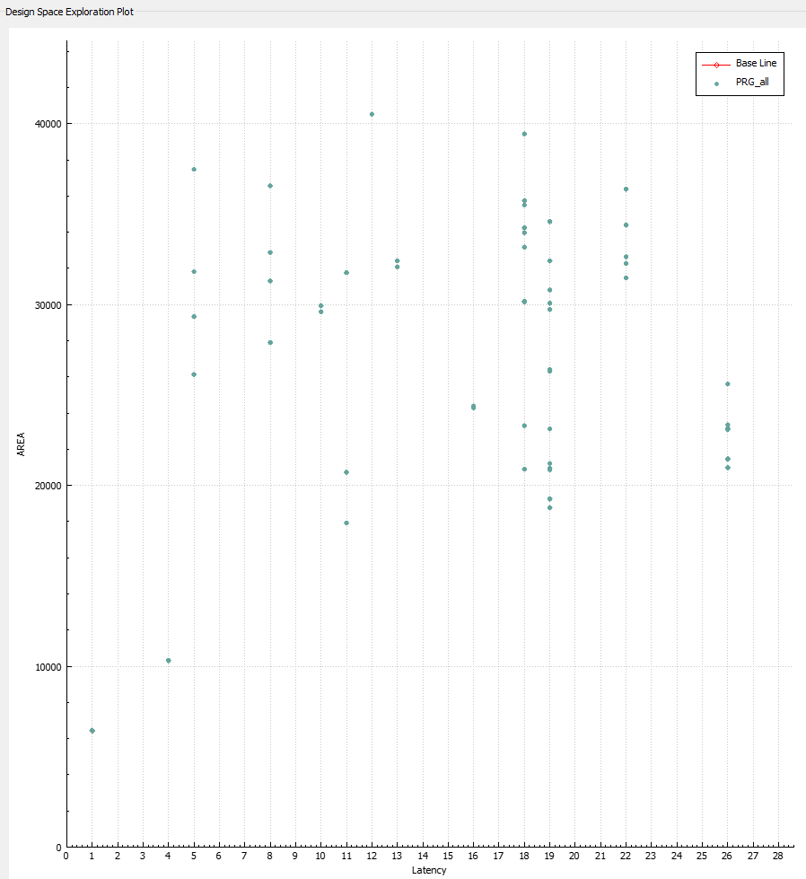
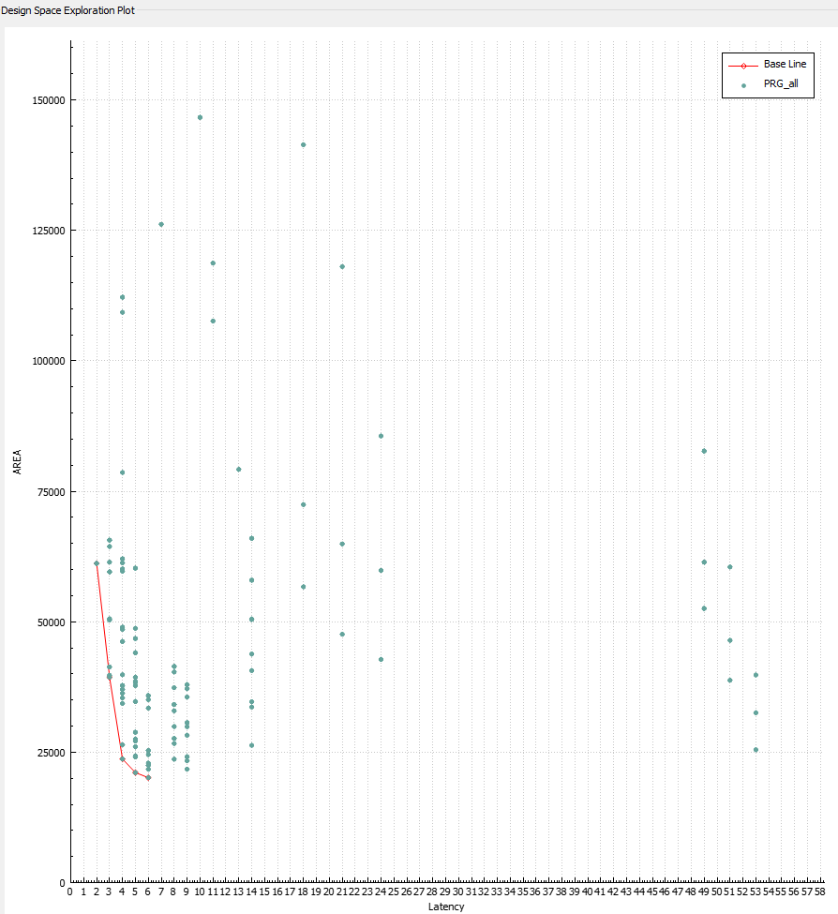
Pragma Search Results
ave16
sobel
kasumi

Slide 8
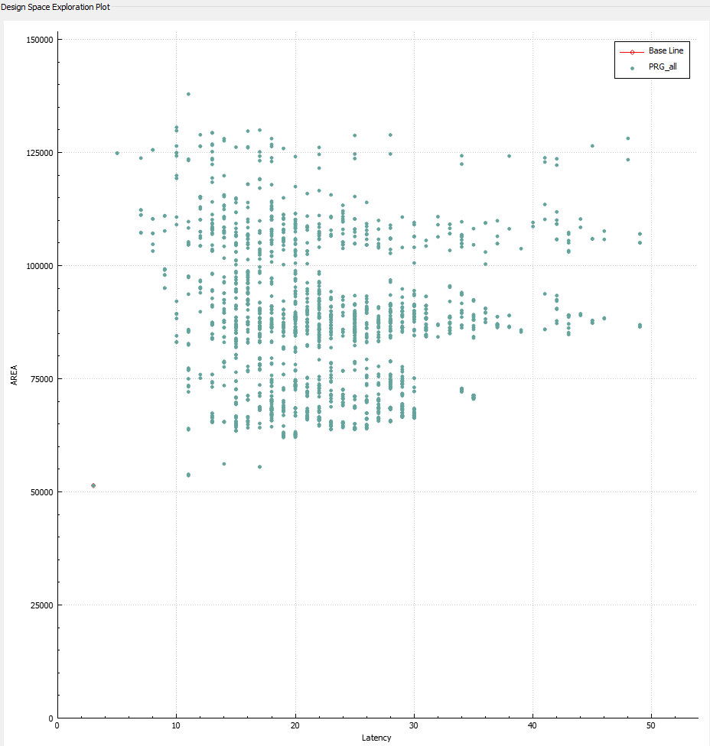
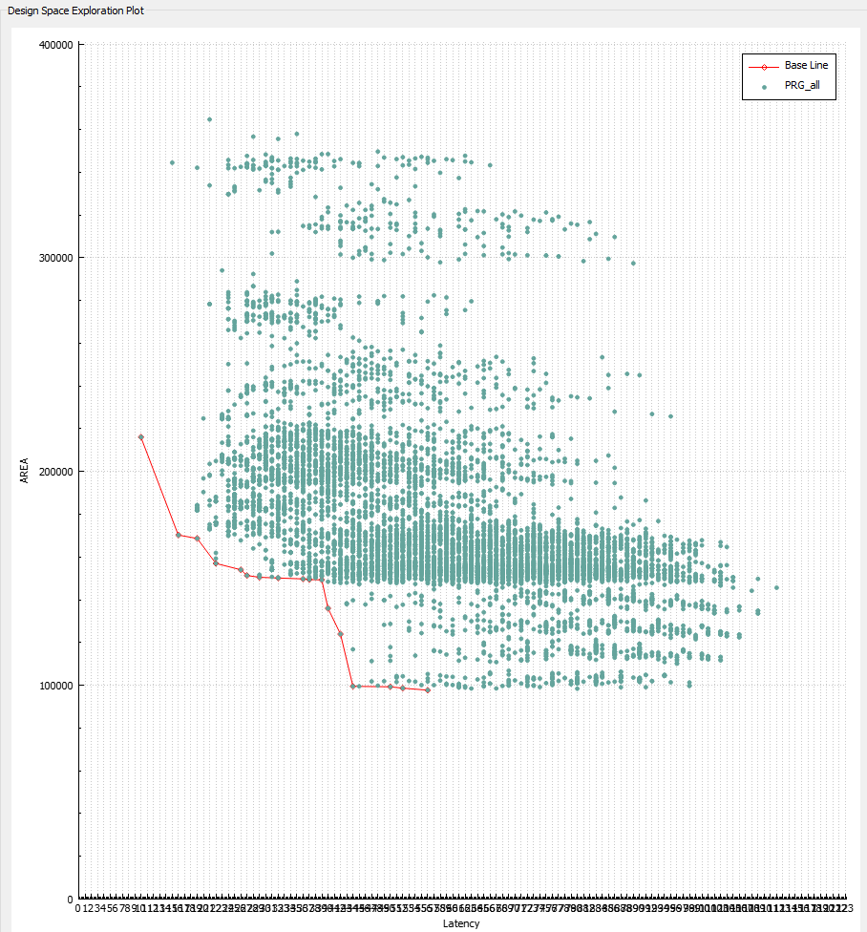
interpolation
decimation

Slide 9
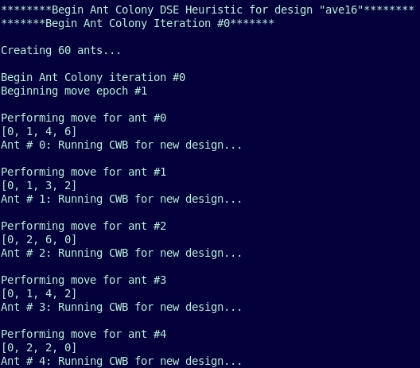
Ant Colony Optimization Heuristic (ACO)
Create numerous “ants” which sniff out the best solutions.
Initially, they move randomly.
Leave pheromones to attract other ants to “good” solutions.
Probability to choose a pragma is proportional to the amount of pheromones.

Slide 10
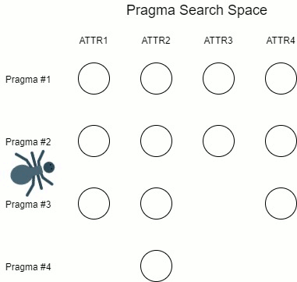
Ant Movement

Slide 11
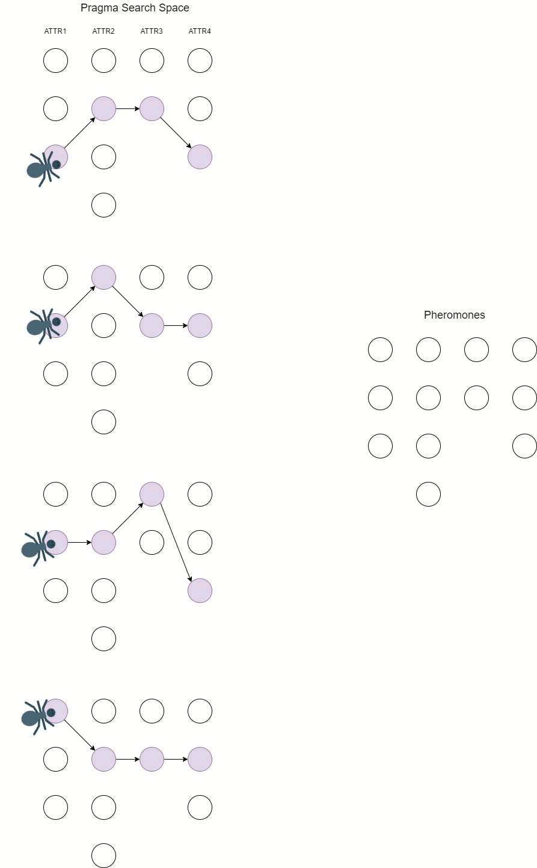
Ants in Action

Slide 12
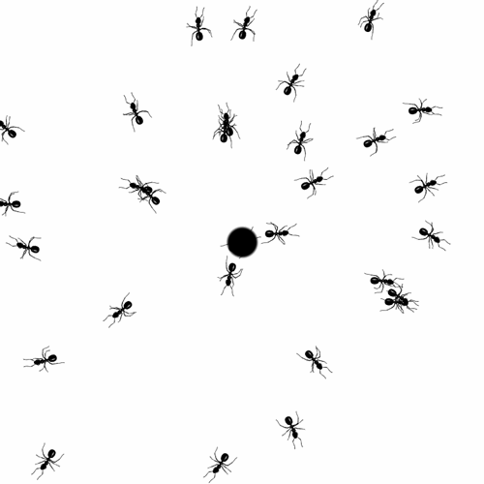
#check if this ant's position has already been evaluated
#to avoid repeating the same work
pos_hash = get_attr_hash(self.pos)
prev_QoR = QoRs.get(pos_hash)
if(prev_QoR != None):
return (prev_QoR, -1, -1)
#else, need to run CWB
#modify the attr.h file according to the ant's position
header_name = name+"/attrs.h"
for i in range(1, len(attr)):
if(i == 1): mode = "w" #on the first line, use write option
else: mode = "a" #on all other lines, append to file
printToFile(header_name, attr[i][self.pos[i]], mode)
#run CWB bdltran, record results
print("Running CWB for new design...")
print(self.pos)
CWB.bdlpars(name)
CWB.bdltran_gen_fcnt(name) #create new .FCNT file for the new parse
CWB.bdltran(name)
method = "ANT"
new_result = CWB.get_results_str(name, method, iteration, pos_hash)
if(new_result == ""): #if result is blank, there was an error
return (9, -1, -1) # cost of 9 means 9 times worse than avg
#write the new result to file
printToFile(results_file, new_result, "a")

Slide 13
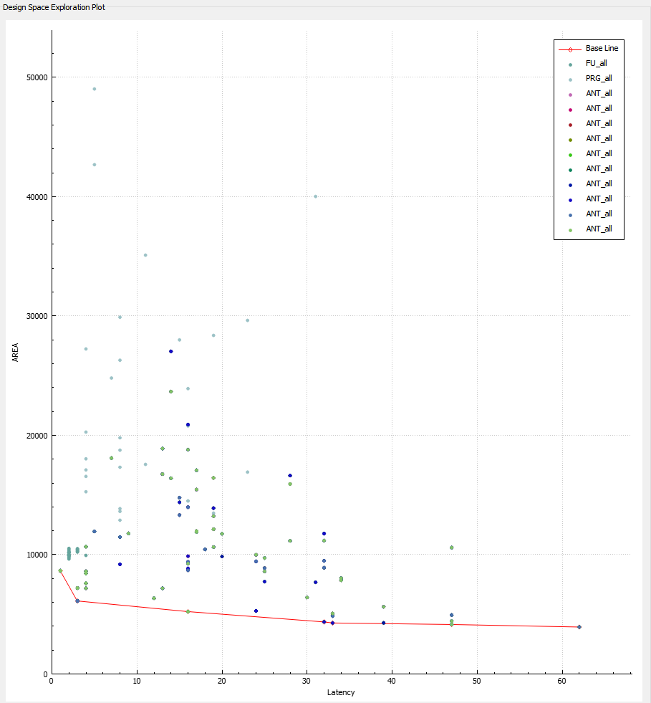
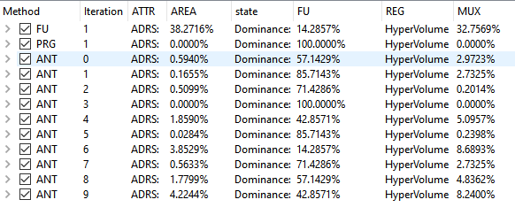
ave16
Exhaustive search has 100% dominance.
Ant Colony ADRS < 5%
Most Ant Colony iterations find majority of pareto optimal.

Slide 14
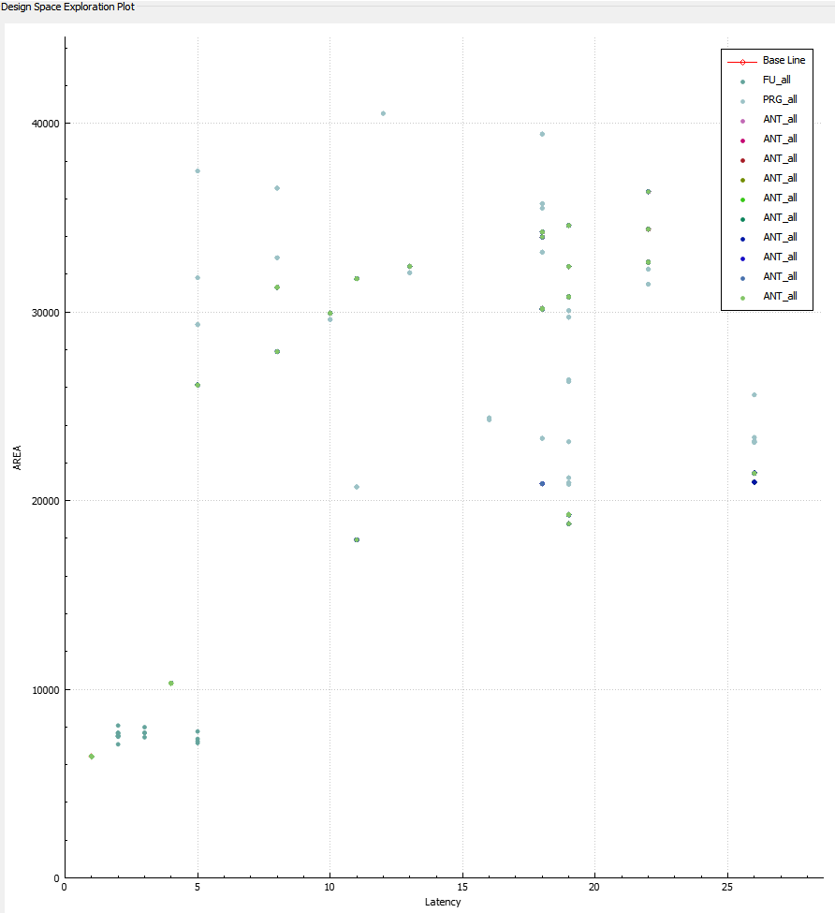
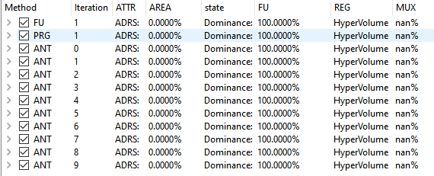
sobel
There is one design which is best in both area and latency.
Boring search.

Slide 15
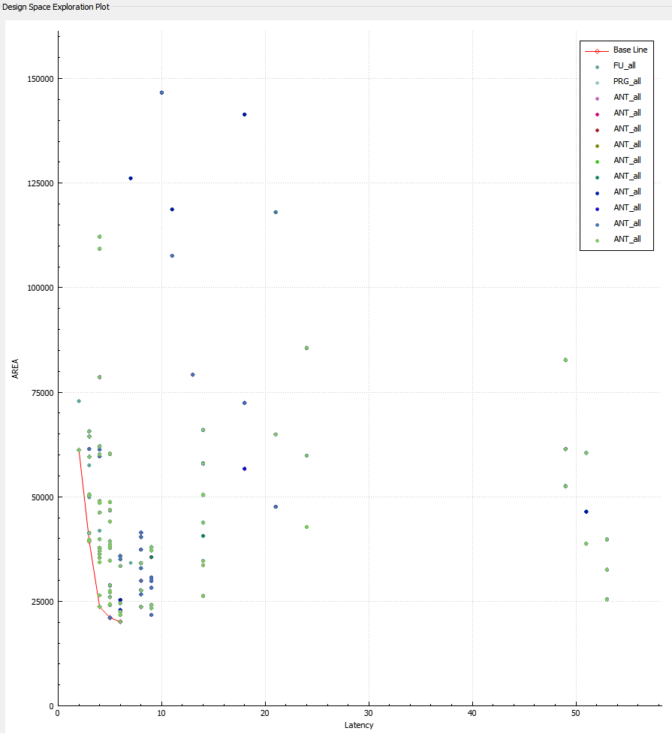
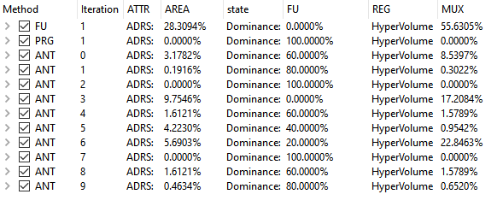
kasumi
Ant Colony ADRS < 10%
Only 5 designs in pareto optimal.
Most Ant Colony iterations find majority of pareto optimal.

Slide 16
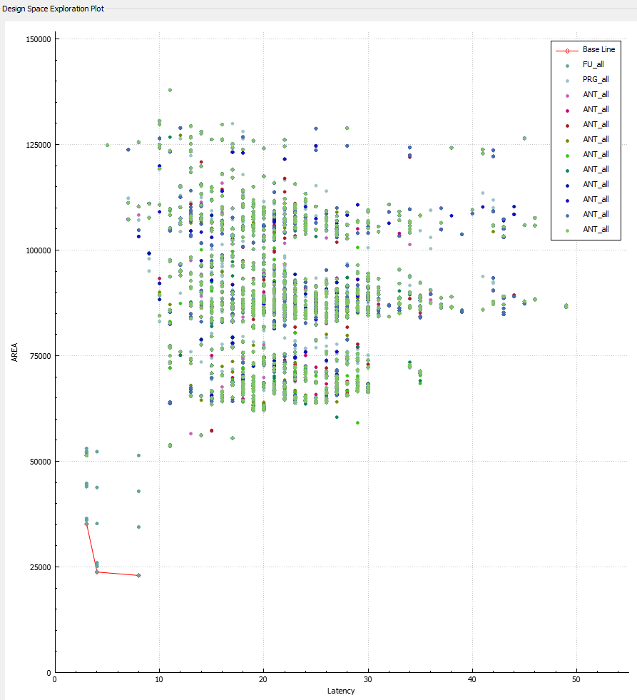
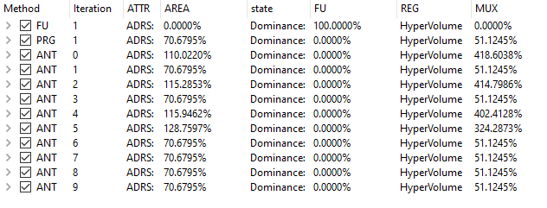
interpolation
For this design, FUs matter more than pragmas!
100% FU dominance

Slide 17
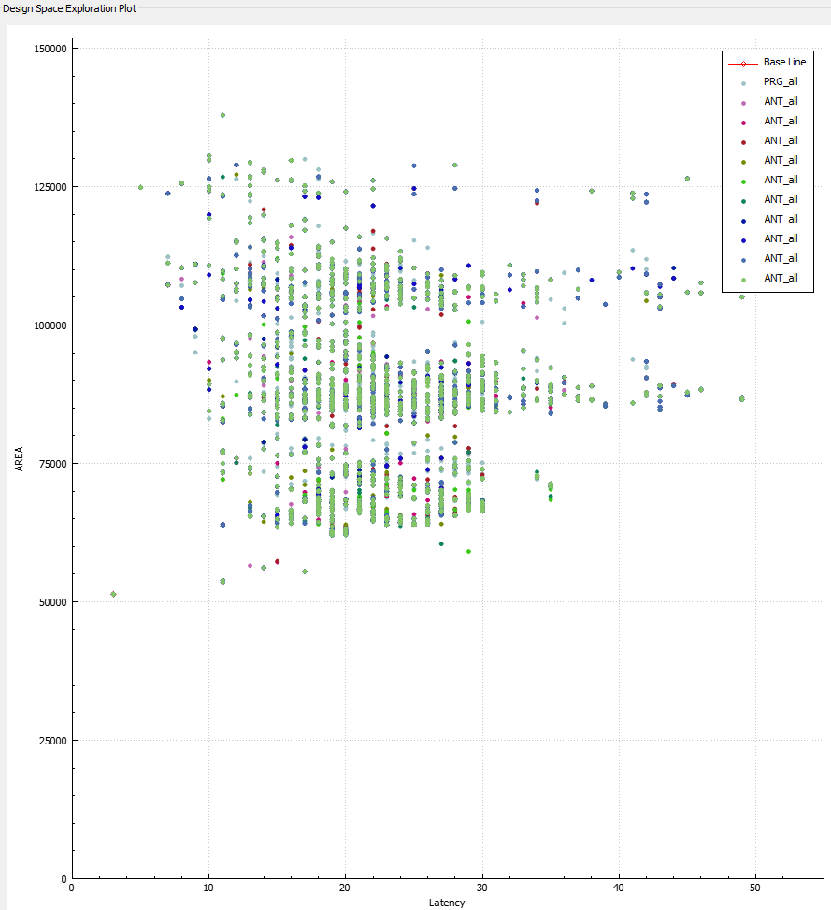
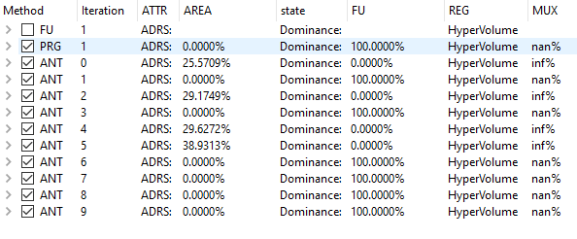
interpolation
A single design has best area and latency.
Most Ant Colony iterations find best design.

Slide 18
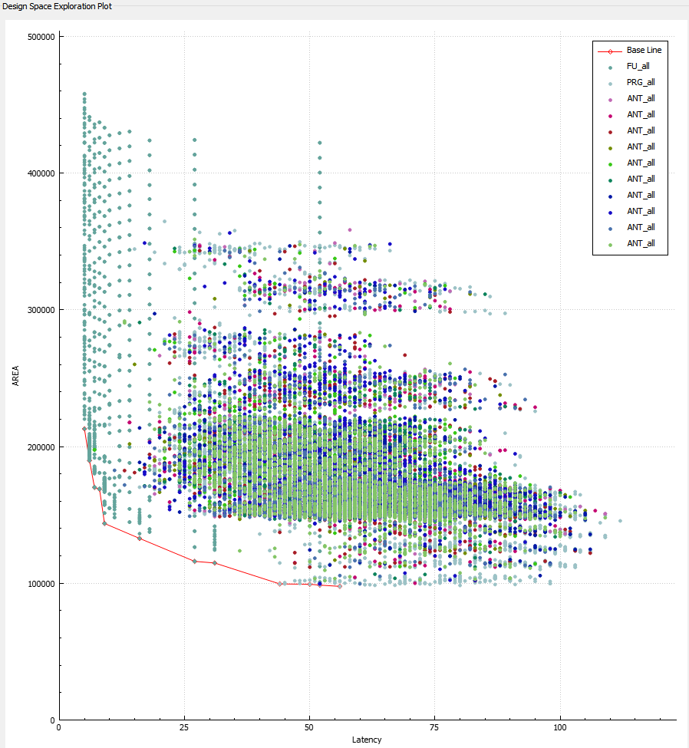
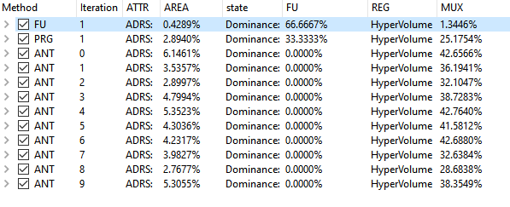
decimation
For this design, FUs matter more than pragmas!
67% FU dominance

Slide 19
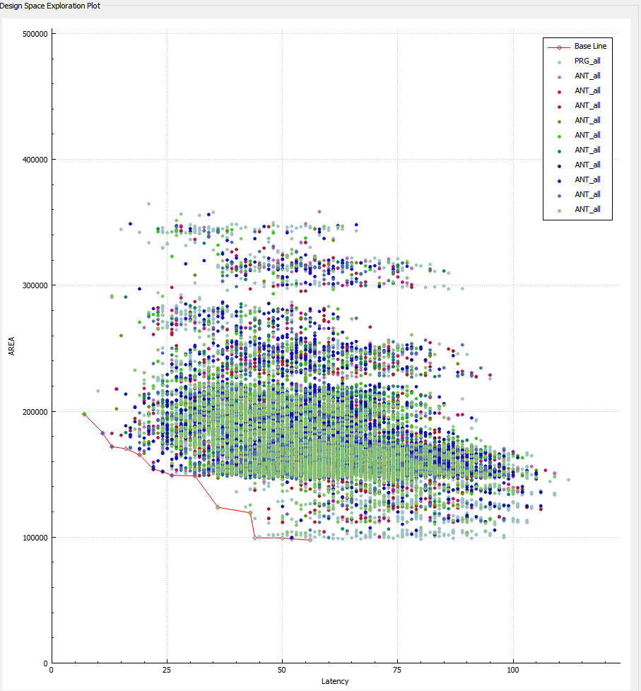
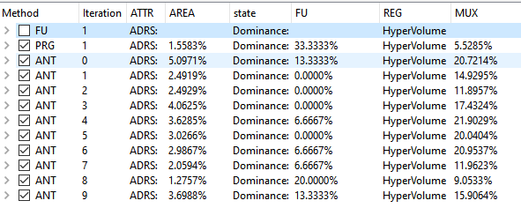
decimation
Semi-exhaustive search only covers ~10% of all possible pragma combinations in 3 days of runtime. Heuristic needed!
Ant Colony performs very well compared to semi-exhaustive search. ADRS < ~5%
Ant Colony finds some designs better than the semi exhaustive search!

Slide 20
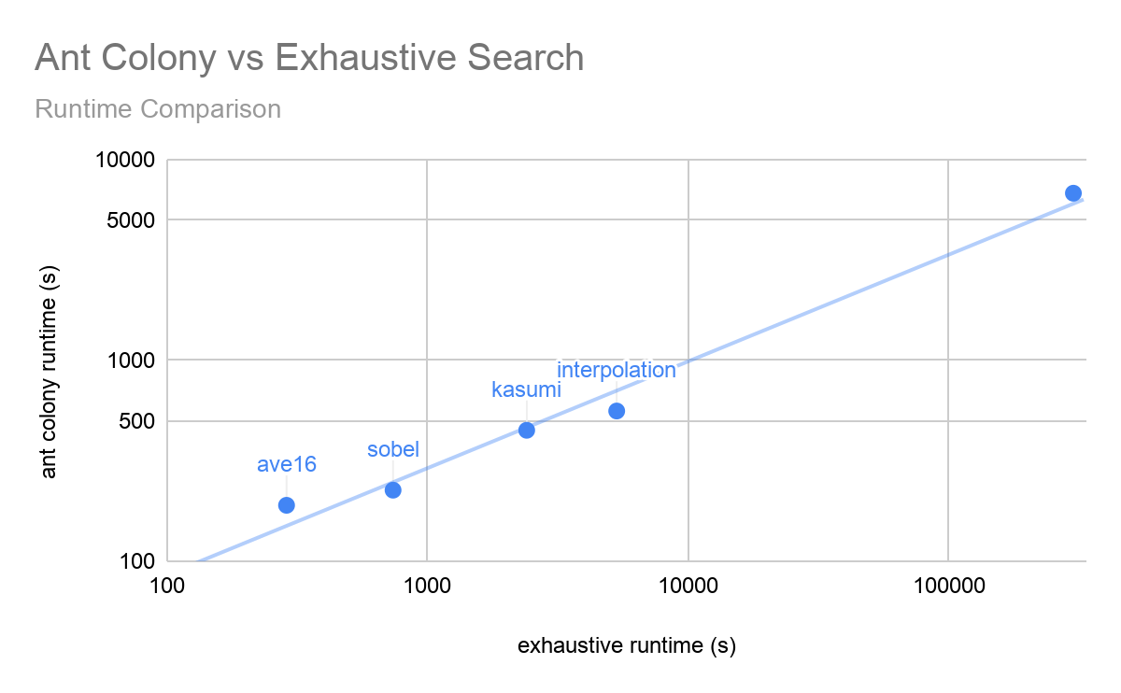
Runtime Comparison
Design | Exhaustive runtime (s) | Ant colony runtime (s) (avg of 10 runs)
ave16 | 289 | 190
sobel | 740 | 226
kasumi | 2407 | 449
interpolation | 5657 | 560
decimation | ~300,000 | 6803
Much faster runtime for large designs!

Slide 21
Hyperparameters
Hyperparameter | Value used | Comment
Number of ants per pragma | 20 | Scales with the search space. More pragmas need more ants!
Amount of pheromone produced per move | 0.5 | Determined empirically.
Pheromone evaporation rate | 0.3 | Results are very sensitive to evaporation rate. Determined empirically.
Convergence Criteria | 0.98 | If at least 98% of ants don’t choose a new path, exit algorithm.

Slide 22
Lessons Learned
Heuristics are absolutely necessary for larger designs. As the dimensions of exploration increases (e.g. pragmas), the runtime of exhaustive searches explodes.
There is nuance to tuning heuristics. A deep understanding of how the heuristic works is needed to set appropriate hyperparameters.
DSE framework does a lot of work for you!
HLS DSE can find optimal designs quickly and efficiently.

